Slide 1

SkillUp EdTech
ONE YEAR PROGRAM PLAN
A comprehensive workstream report covering free training, webinars, secondary schools, and the online academy for a year.

Slide 2



Executive Overview
SkillUp EdTech is deploying a four-pillar model to bridge the national skills gap. Our objective is to transition from a social-impact focus to a high-scale commercial engine.
4 Workstreams
4-Month Cycles
Integrated learning pathways for all ages.
Agile rollover for continuous scaling.
Annual Revenue Target
70M NGN
200 Base
10k Goal
Initial free subscriber milestone.
Paid subscribers by Year-End.

Slide 3



THE PROBLEM
WE'RE SOLVING
600K+
Graduates per year with no job-ready digital skills
Nigeria's Skills Gap Crisis
72%
Millions of graduates enter the workforce every year, yet the digital economy remains understaffed. The gap between academic output and industry-ready talent is widening — and SkillUp EdTech was built to close it.
Of Nigerian employers report tech skills shortfalls in new hires
< 5%
Graduates possess foundational coding or cybersecurity competency
SkillUp EdTech bridges the gap — from classroom to career-ready.

Slide 4



WHO WE SERVE
Three integrated learner segments — one ecosystem.
AI SECONDARY
FREE TRAINING
ONLINE ACADEMY
Secondary
School Students
Recent Graduates
& Job Seekers
Working Adults &
Self-Directed Learners
Ages 11 – 18
Ages 18 – 30
Ages 22+
Future-ready skills layered atop standard curricula. AI literacy, digital safety, and computational thinking embedded in the classroom.
Talent-screened cohorts trained in Cybersecurity, AI, Product Design, and Software Development. A ₦25K commitment model ensures serious learners.
Flexible, subscription-based LMS with monthly new certifications. Designed for career changers, upskilling professionals, and entrepreneurs.
30 schools by end of Year 1
1,200+ trained experts/year
10,000 paid subscribers by Year-End

Slide 5





The Strategic Workstreams
Free Training
Webinars
AI for Professionals
Summer Training
ACTIVE
Advanced tech courses (Data, Cyber, AI for work, Design, Dev) with 25k commitment fee.
Monthly tech advocacy & industry innovation sessions.
This is a special physical classes for Accountants and Administrators on the use of Ai
Special training for children and undergraduates willing to upskill during the break
Pending
AI Secondary
Online Academy
In- House Personal Training
Embedding future-ready skills in classrooms across 10 - 30 schools.
The commercial engine: scaling to 10,000 paid subscribers annually.

Slide 6
ARCHITECTURE
Two-Engine System: Website + LMS
Public Website — Front-End Hub
LMS Portal — Secure Delivery Engine
Your marketing engine, conversion funnel, and e-commerce storefront. Manages discovery, scheduling, pricing visibility, and payment checkouts.
Your fulfillment engine. Handles automated student provisioning, content hosting, performance tracking, live integrations, recurring subscription access, and certification.

Slide 7


Advanced Tech: Free Training Model
4-Month Plan
•
Acceptance Fee: 25,000 NGN (Commitment model).
•
Cycle Frequency: Every 4 months (3 cohorts/year).
•
Selection: Talent-based screening for motivated graduates.
•
Curriculum: High-impact vocational skills.
Capacity: Min 100 learners per course.
Total Output: 1,600+ trained experts/year.

Slide 8


Training Core Curriculum
Cybersecurity
Data Analysis
Focus on Forensic, ethical hacking, and network security for the digital economy.
Advance, Business intelligence deployment, using several tools and crating solution around business cases
Product Design
Software Development
UI/UX mastery, prototyping, and user-centric design frameworks.
Full-stack capabilities across web and mobile platforms.
AI For Work
How learners can maximize AI tools for business and workspace

Slide 9
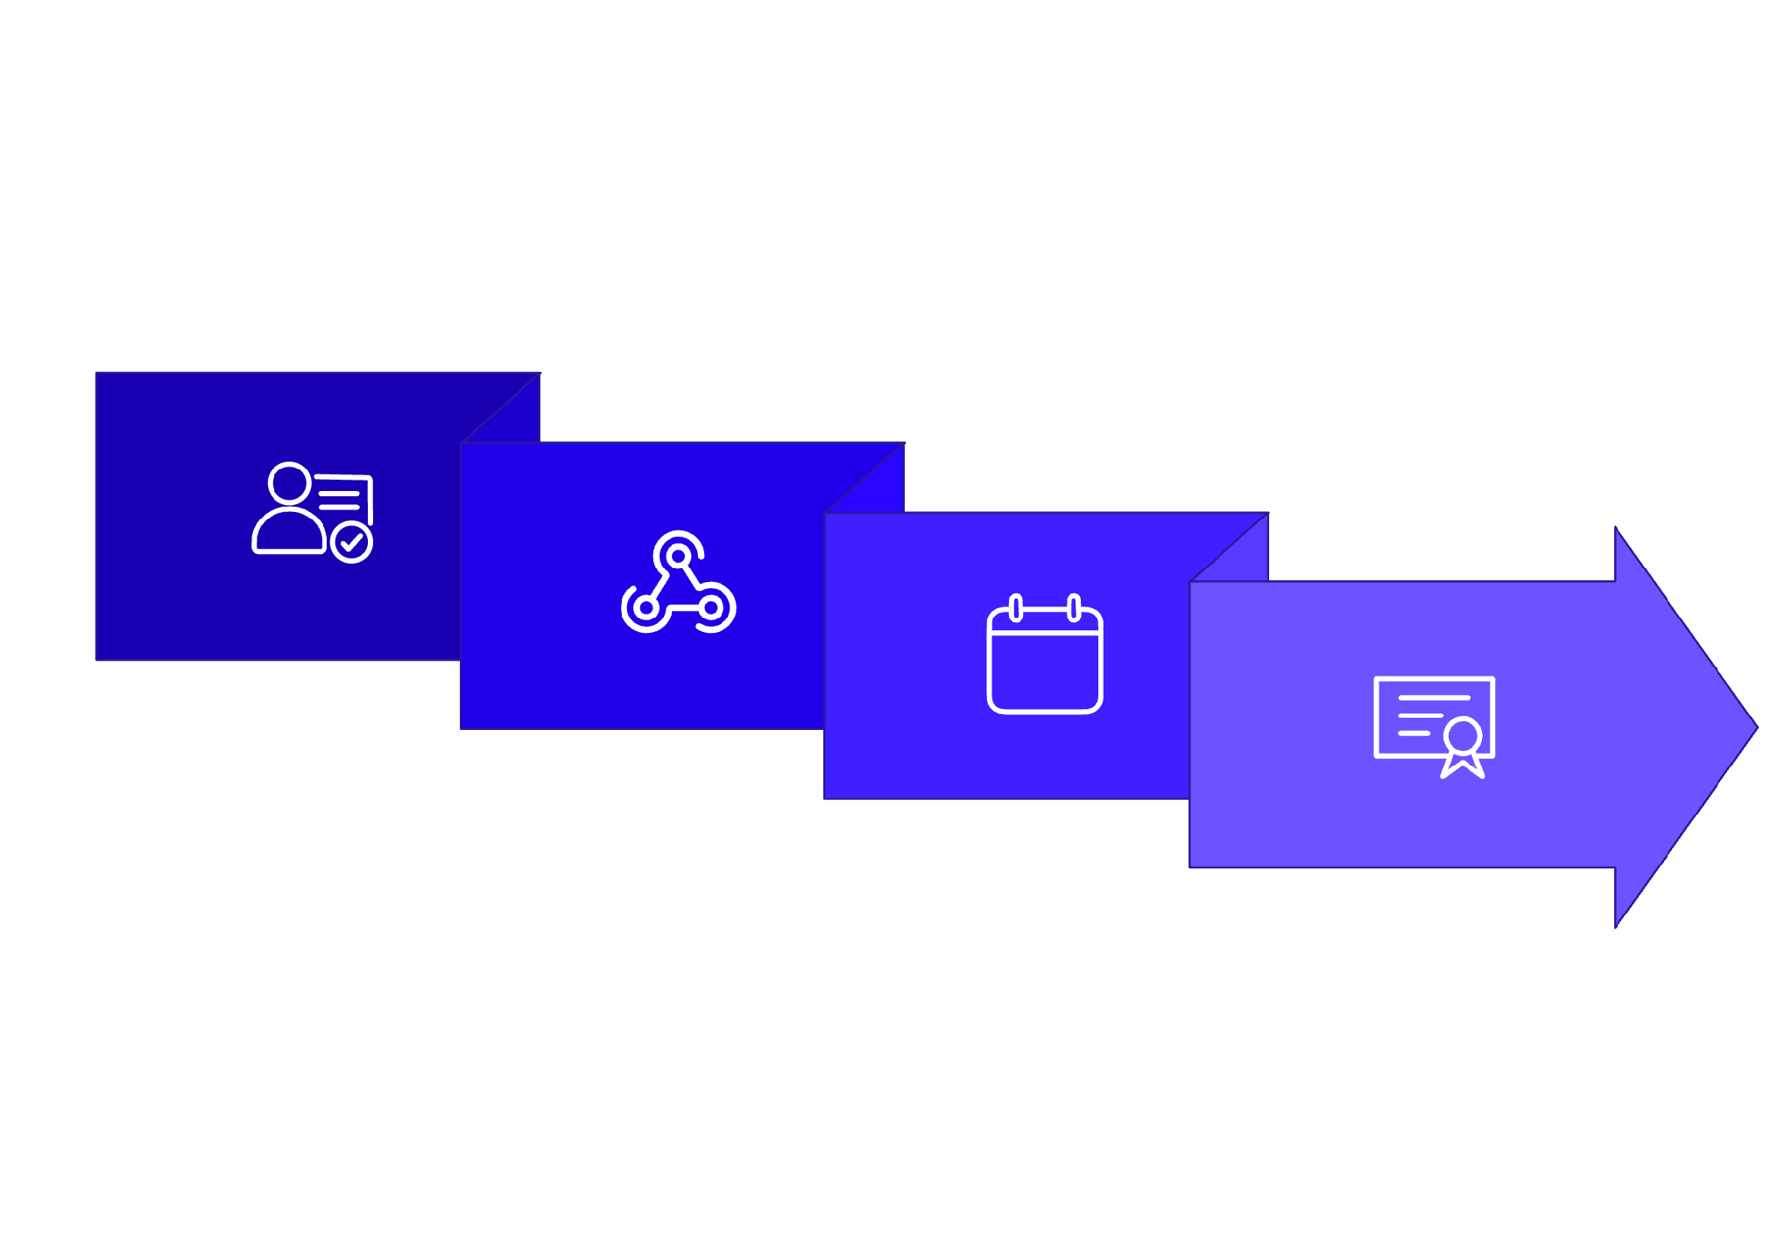
PRODUCT 3
Free Training — Blended Hybrid
Format: Blended Hybrid · Commitment Fee: $25k · Objective: High engagement & certification across 5 core tracks: Data, Cyber, AI for Work, Design, Dev.
Webhook Enrollment
Project & Cert
Register + $25k
Weekly Drip + Live
The $25k commitment fee filters low-intent users. Upon payment, webhooks auto-provision LMS credentials, unlock weekly drip content, and trigger certification at full completion.

Slide 10
Free Blended Core Funnel
Web Front-End Store
LMS Automated Delivery
High-demand tracks (Data, Cyber, AI for Work, Design, Dev) configured to acquire serious learners via financial filters.
Once payment clears, our system engine automatically initiates programmatic learner access.
➔
Mandatory checkout gateway setup for ₦25k commitment fee.
➔
Automated Credentialing: Instantly sends LMS credentials and course access parameters.
➔
Transparent publishing of core syllabus details directly on website storefront.
➔
Hybrid Interface: Host dripped content lectures alongside one scheduled live API touchpoint.
➔
Dynamic enrollment caps built to regulate participant influx.
➔
Automation Output: Autorelease certifications upon 100% video completion & pass grades.

Slide 11
PRODUCTS 4–5
Webinars & B2B School Program
Monthly Webinars
AI Secondary — B2B School Program
Format: Live Virtual → On-Demand · Objective: Brand awareness & lead generation
Events section with speaker profiles and countdown timers. Lead-capture registration feeds into LMS — recorded sessions archived within 24 hours to convert visitors into free LMS users.
Format: In-person + digital resources · Target: 10–30 schools
B2B landing page for school proprietors and PTA boards. Onboarding form captures school data; LMS issues bulk student/teacher credentials and hosts supplemental coding guides and teacher kits.

Slide 12
Monthly Webinars Process
1. Promote & Capture
2. Deliver Live
3. Archive & Nurture
Public website features upcoming schedules, countdown timers, speaker portfolios, and quick registration forms to drive high-intent leads into the funnel.
Broadcast monthly sessions live using Zoom or YouTube integrations. Maintain highly interactive discussion forums to prompt organic platform conversions.
Within 24 hours of ending, edit and upload the webinar record into the LMS "Webinar Vault." Unlocks on-demand viewing upon signing up for a free student profile.

Slide 13
Webinars
Website Implementation Requirements
Process for Implementation
Webinars dedicated page (information & past sessions)
Upcoming events calendar with registration
Past webinar recordings (embedded)
Speaker spotlights
Clear CTA: “Watch Live” or “Join Next Session”
Planning — Monthly topic selection + speaker outreach
Promotion — Website, socials, email lists, school partners
Delivery — Live streaming (YouTube/Zoom integration)
Post-Event — Recording uploaded to website + added as on-demand course in LMS
Follow-up — Automated nurture sequence leading to Free Training or Academy

Slide 14


PROPOSED TOPICS
Projects, Mentorship & Proof: Why Some Tech Learners Get Hired Faster
Tech Community Power: Navigating the Ecosystem for Fast Growth
Founders Panel: Stories, Struggles & Breakthroughs in Tech
Remote Work & the Global Tech Market
Uncovers what separates job-ready tech learners from the rest: real projects, the right mentors, and a portfolio that proves your skills.
Understand how joining local and global tech communities can unlock hidden job markets, mentorship, and invaluable peer support.
Learn how African tech talent can access international remote opportunities and compete in the global digital economy
Real founders share honest lessons on building tech ventures, from first idea to surviving early-stage challenges
Cloud & DevOps: The Engine Behind Modern Tech Products
Soft Skills for Hard Tech: The Ultimate Career Accelerators
Cyber Alert: Staying Safe in a Digital-First World
Riding the Next Tech Wave: Data, AI, and the Future
Demystifies cloud computing and DevOps practices, showing beginners how modern software is built, deployed, and scaled
Master the art of communication, emotional intelligence, and problem-solving that turns good techies into irreplaceable, highly-paid team leaders.
Breaks down real-world cybersecurity threats and equips everyday users and beginners with practical online safety habits
Explores how AI and data science are reshaping every industry, and how anyone at any level can get involved
Leveraging the EdTech Revolution: Modern Learning for Fast Growth
Unlocking Your Value Proposition
Tech & Money: Freelancing, Remote Work & Building Income Online
Basic Tech Tools 2027: Your Beginner Starter Kit
Learn how to strategically navigate online bootcamps, certifications, and digital resources to accelerate your personal tech growth on your own terms
Learn how to identify and pitch your unique strengths so potential employers see you as a necessity rather than an option
Guides learners on how to monetize tech skills through freelancing platforms, remote jobs, and digital income streams.
Introduces the most essential free and low-cost digital tools every tech beginner needs to know and use right now.

Slide 15


AI Secondary School Plan
Nurturing Tomorrow's Talent
Meeting students where curiosity is highest. A term-based engagement model layering AI and digital literacy atop standard curricula.
Pilot Strategy: 10 selected schools in Term 1 to refine the pedagogy before scaling.
Facilitators: Corp members will be employed for the training (1 corp meber to 5 schools)

Slide 16
AI Secondary School Program
B2B Classroom Embedding
Key Features
Bringing hands-on digital training curriculum into 10–30 secondary schools in Lagos and Ogun States.
• Term-based engagement
• Layered on top of standard Nigerian curriculum
• Hands-on workshops (AI tools, digital literacy)
• Facilitated by trained NYSC corp members
Web Lead Capture: B2B portal targeted at school administrators and proprietors.
Supplemental LMS Resource Support: Hosting lesson outlines, projects, and study guides for students to access outside the computer lab.

Slide 17

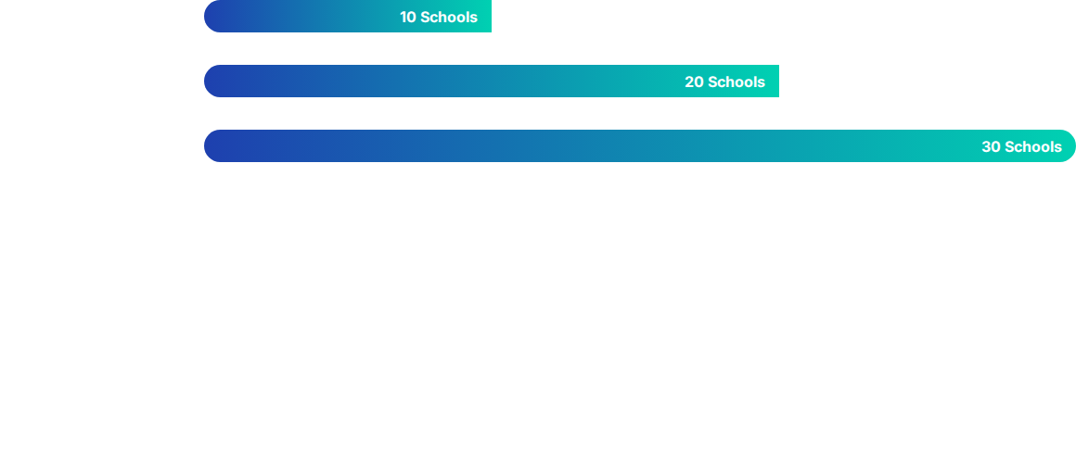
SCHOOL ENGAGEMENT FRAMEWORK
VISITS
PROPOSALS
SCHEDULING
DELIVERY
Relationship building with administrators.
Customized value-props for school boards.
Integration with term calendars.
On-site facilitator-led workshops. (Corp member to be recruited to facilitate)
Minimum Student to be enrolled per school : 50.
Aggregated Reach: 30 school-term engagements by Year 1 completion.

Slide 18
AI Secondary School Program
Website Implementation Requirements
Process for School Partnerships
• AI-secondary page
• School partnership application form
• Program overview with benefits for schools/students
• Case studies / pilot results (as available)
• Facilitator recruitment information
1. Outreach & initial visits
2. Customized proposal submission
3. Agreement & scheduling
4. Facilitator deployment (1 corp member : 5 schools)
5. Program delivery & feedback loops
6. Reporting to school administration

Slide 19
GTM — CAMPAIGNS
B2C & B2B Campaign Strategy
B2C — Professionals, Kids & Undergrads
B2B — AI Secondary School Program
Hyper-targeted LinkedIn and Meta ads focused on Accountants, Administrators, and Parents in Lagos/Ogun. Short-form video content (Reels, TikToks, Shorts) showcasing student success stories to drive direct website registrations.
High-quality digital and physical corporate proposals, pitch decks, and case studies for school proprietors. Targeted email and LinkedIn campaigns directed at school board members and key academic stakeholders.

Slide 20





Online Academy: The Flagship LMS
The Flagship Commercial Engine. Scaling from discovery to career-ready qualification via a powerful LMS ecosystem adding 2-3 new certification courses to the LMS every month. This ensures recurring value for our subscriber base.
Scaling Mechanism
Library Growth
Cross-Selling
Marketing Engine
Continuous content addition monthly to keep subscriptions relevant and retain learners.
New content modules added every 30 days. Diversified tracks for Tech, Business, and Soft Skills.
Leveraging Free training graduates and Webinar attendees to fuel paid Academy enrollments.
Continuous campaign cycles focused on subscriber retention and lifetime value (LTV).
Subscriber Target: 200 (Pilot) → 10,000 (Year End)
10,000 NGN / Month Access
Recruit → Enroll → Facilitate → Reload/Cross-sell

Slide 21

Academy Revenue Model
₦10,000
Projected Annual Revenue
Based on 10,000 active subscribers by year-end across varying course tiers.
Full Course Fee
70% - Crash Course- 17.5M 30% Full Course - ₦30M
₦2,500
₦47.5M+
Estimated Gross Revenue from LMS
Crash Course Fee

Slide 22
PRODUCT 6
Online Academy — Subscription Engine
Format: 100% digital self-paced · Target: Scale to 10,000+ subscribers. Website acts as searchable, filtered course marketplace.
Tier
Business Dynamic
LMS Access
A. Crash Course
Single micro-purchase
Lifetime access to that specific module only
B. Full Course
Premium standalone purchase
Lifetime access to full specialization track + certification
C. Monthly Subscription
Recurring All-Access Pass
Unlimited library access; auto-revoked if subscription lapses

Slide 23
Tech Infrastructure & LMS Readiness
LMS Capacity
Application tracking and Communication
Cloud-native architecture capable of supporting 50,000+ concurrent learners by Year 3.
Set a triggered messages for each and every phase of the attempted application or activities
Course Chain
Data Analytics
Marketing of Other courses just before or immediately after compilation of a course
Embedded tracking for learner progress, retention rates, and cross-sell conversion metrics.

Slide 24
IMPLEMENTATION
Technical Implementation Checklist
Content Production Pipeline
Web & LMS Engineering
Finalize curriculums for 15+ crash courses and core tech tracks
Script facilitator presentations and establish video recording guidelines
Set post-production schedules for steady content release
Connect web forms to LMS via webhooks/API for automated account generation
Deploy recurring billing (Paystack/Flutterwave) for monthly subscriptions
Configure LMS grading engine to auto-issue digital certificates on completion

Slide 25
Summer Training Funnel
Dynamic Physical Bootcamps
Engaging holiday tech tracks configured to capture children, teens, and undergraduates looking to upskill.
Front-End Interface: Multi-tiered web checkout pages separating track options (Kids vs. Undergrads).
Back-End Registration: Parental consent flow and cohort allocation thresholds fully maintained on backend databases.

Slide 26

GTM — LIFECYCLE
Lifecycle Marketing & Engagement
Webinar Registrant
Free LMS User
Paid Monthly Subscriber
Custom automated email sequences convert users at each stage of the product journey — from first touchpoint to paying subscriber.
Conversion Optimization
Engagement Conversion
Targeted mid-month email promotions highlighting new course additions to drive active subscriber retention and reduce churn.
Direct non-paying website visitors to create free LMS accounts to access the Webinar Vault — bringing fresh leads into the product ecosystem.

Slide 27
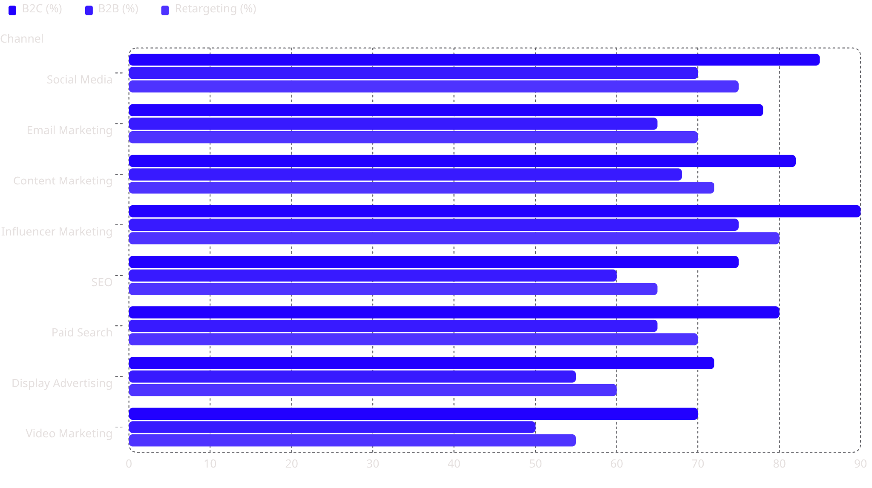
Marketing Channel Usage by Segment
B2C consistently leads channel adoption across all categories, followed by Retargeting and B2B. Influencer Marketing shows the highest overall usage at 90% for B2C campaigns.

